Slide 1



Inventory Manangement and sales analysis
View in Power BI
Last data refresh:
3/17/2023 10:53:01 AM UTC
Downloaded at:
3/17/2023 11:12:38 AM UTC

Slide 2
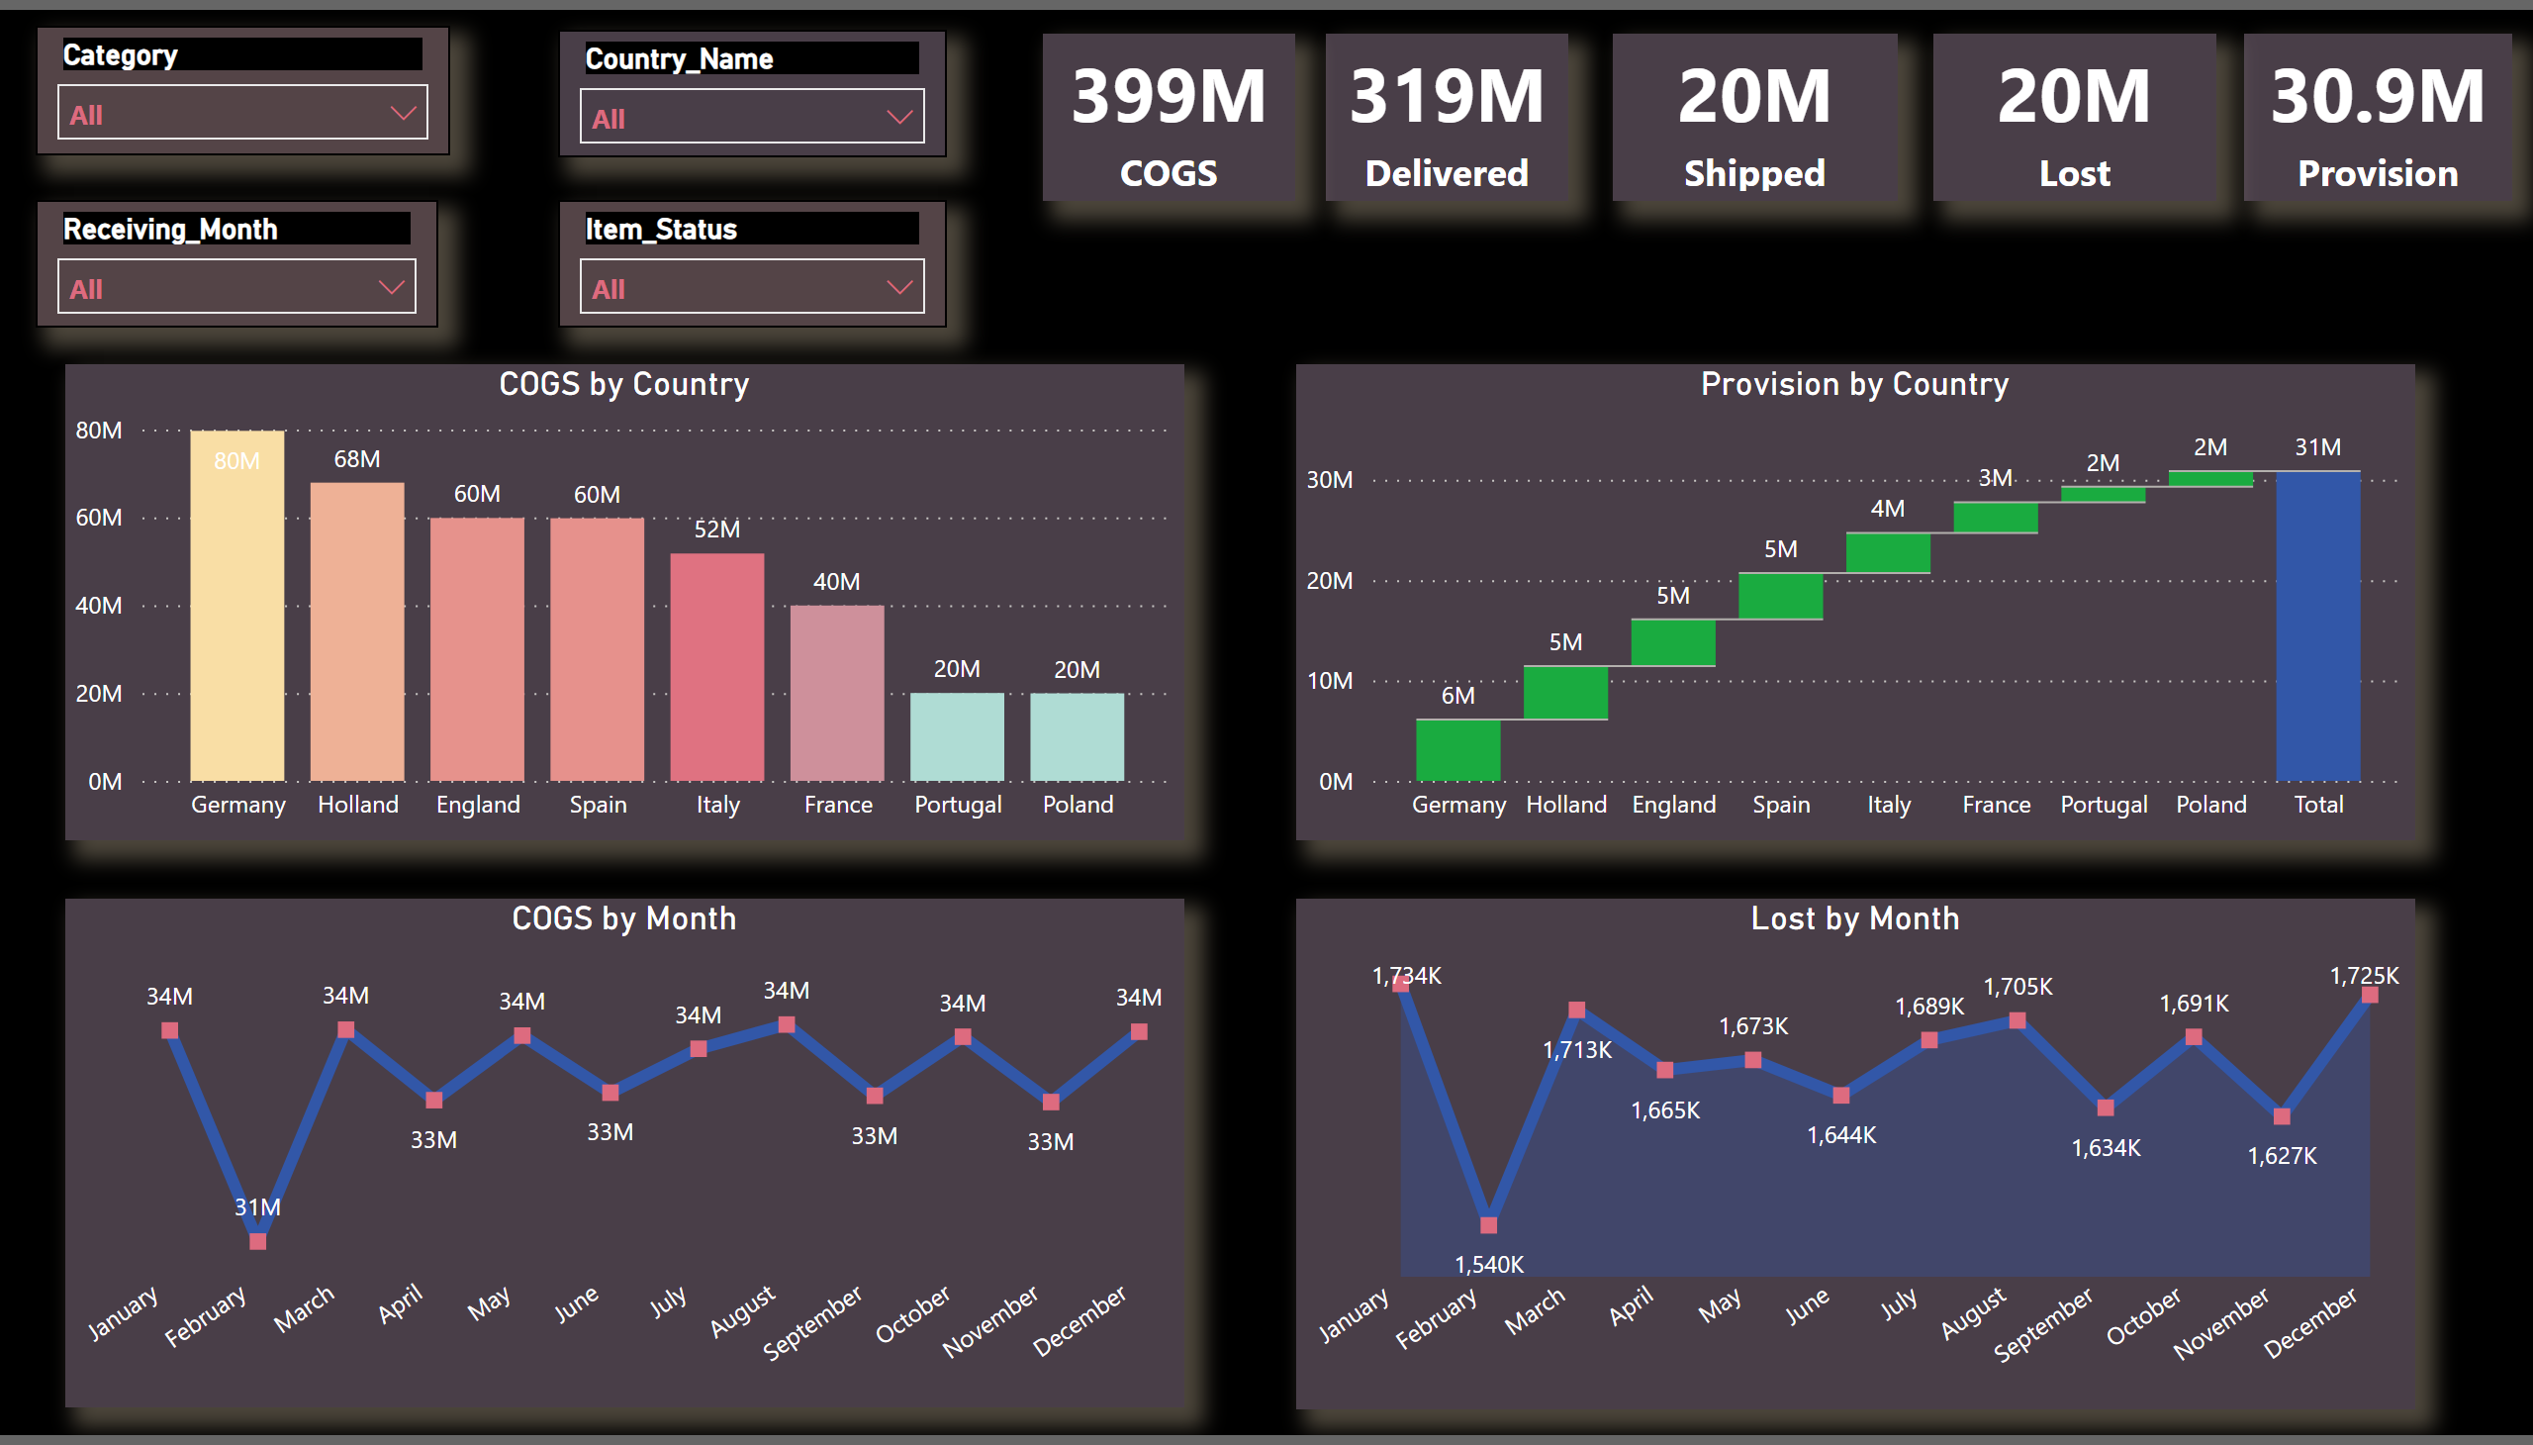
Inventory Management analysis
Notes:
card
No alt text provided
card
No alt text provided
card
No alt text provided
card
No alt text provided
card
No alt text provided
slicer
No alt text provided
slicer
No alt text provided
slicer
No alt text provided
slicer
No alt text provided
COGS by Country
No alt text provided
Provision by Country
No alt text provided
COGS by Month
No alt text provided
Lost by Month
No alt text provided

